Slide 1
CHALLENGE RESULT
01
Customer Churn Prediction Model

Slide 2
Customer Churn Prediction Model
Dataset
This machine learning model is created using a telecommunication company dataset of customer churn. The data contain a total 4250 row and 19 column + 1 column showing customer churn
Preview of data
state | account_length | area_code | ……….. | churn
OH | 107 | area_code_415 | ……….. | no
NJ | 137 | area_code_415 | ……….. | no
OH | 84 | area_code_408 | ……….. | no

Slide 3
Customer Churn Prediction Model
Internet service is something we used on a daily basis and it become one of main revenue for telecommunication company.
Customer churn is when a customer switch internet provider and this can lead to lower revenue for telecommunication company so this problem need to be deal with
Background
Stakeholder
The stakeholder for project is telecommunication company providing internet service
General Goals
Creating a machine learning model that can predict customer churn using the dataset provided

Slide 4
Machine Learning Model
The steps taken to create the model is as following
01
Data Exploration
04
Data Splitting
02
Data Preprocessing
05
Data Training and Testing
03
Feature Engineering
06
Ensemble Method

Slide 5
01
Data Exploration
First we need to preview the dataset
state | account_length | area_code | ……….. | churn
OH | 107 | area_code_415 | ……….. | no
NJ | 137 | area_code_415 | ……….. | no
OH | 84 | area_code_408 | ……….. | no

Slide 6
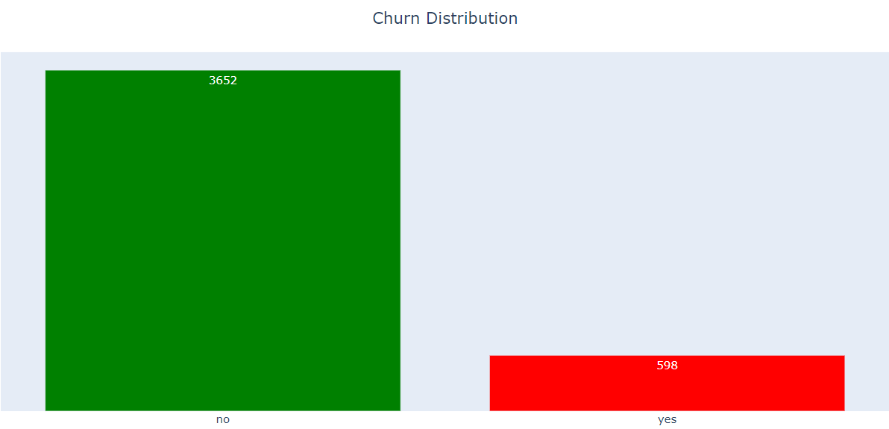
01
Data Exploration
Then we should see the dataset distribution of churn

Slide 7
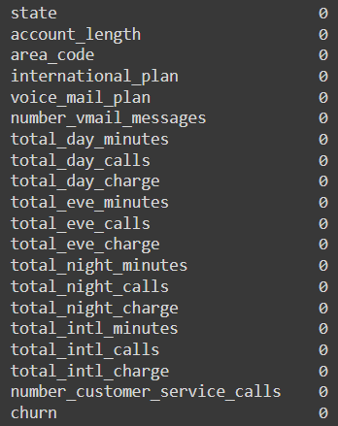
01
Data Exploration
We should check if there is any null value in our dataset

Slide 8
01
Data Exploration
We should divide our dependant and independent variables in this case our dependant variable is churn and our independent variables are other columns beside churn
Next we should divide our independent variables categorical value and numerical value meaning we have 15 numerical and 4 categorical value
Then we check our independent variables distribution for churn with yes and no status using bar chart for categorical values and histogram for numerical value

Slide 9
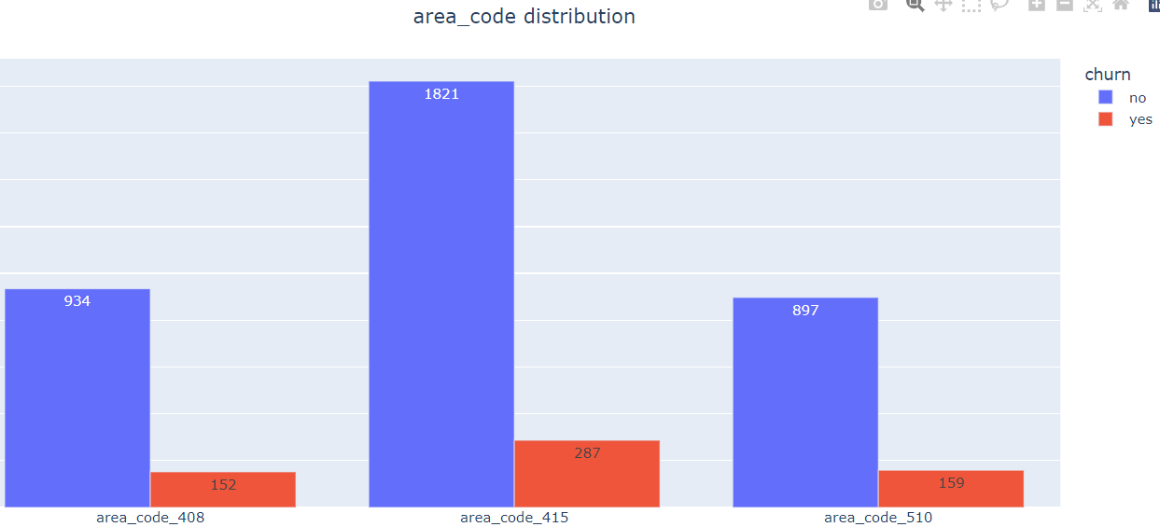
01
Data Exploration
Example for categorical value

Slide 10
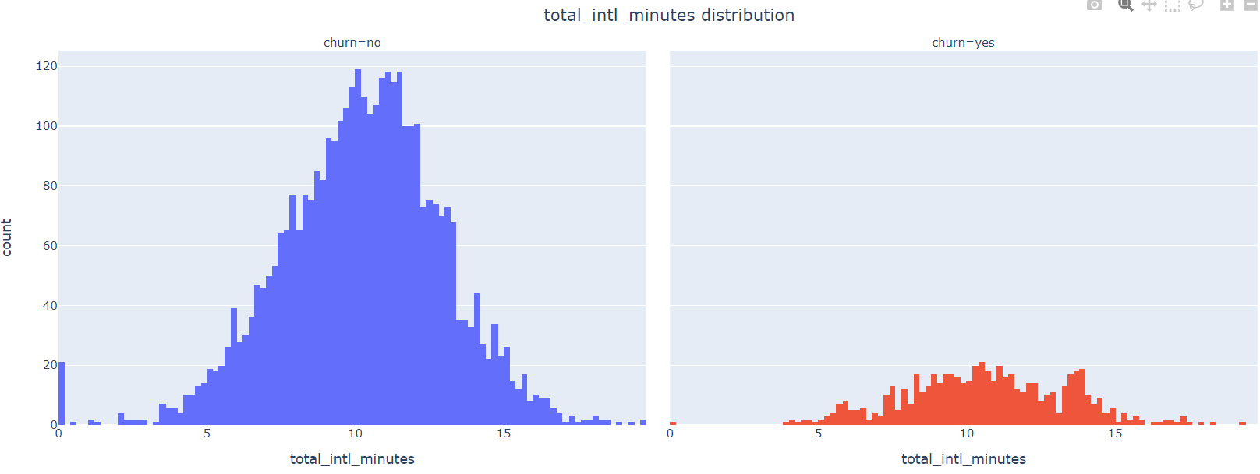
01
Data Exploration
Example for numerical value

Slide 11
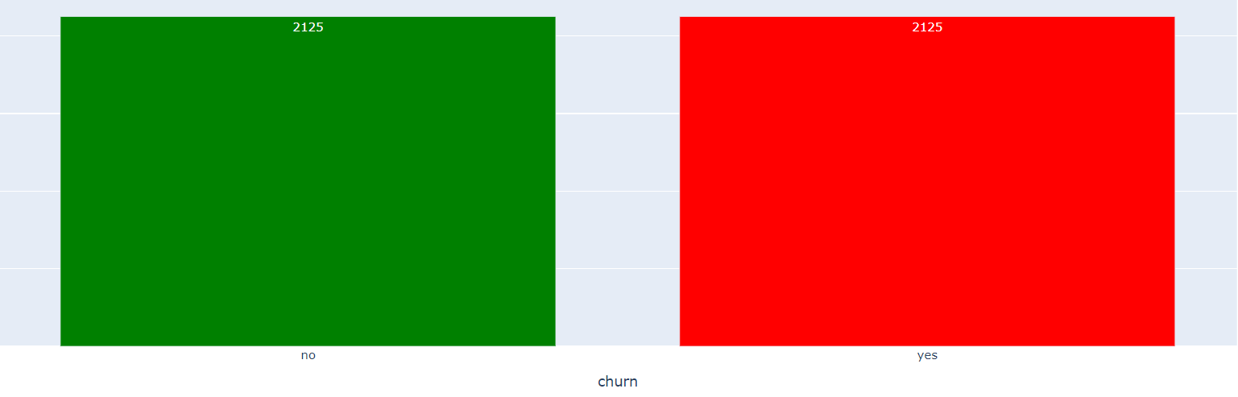
02
Data Preprocessing
After exploring our dataset we will perform data preprocessing
Resampling
First we need to perform Resampling because the distribution of churn class is very uneven with having way more Churn No than Churn Yes
We will use oversampling for the minority class and undersampling for the majority class. Then we will have 2125 sample for each class

Slide 12
02
Data Preprocessing
Categorical Value
Next we will perform Encoding for our categorical value and because all the categoricals are a nominal data we will perform One Hot Encoding
Example One Hot Encoding
state:AK | state:AL | state:AR | ……….. | state:WY
0 | 1 | 0 | ……….. | 0
0 | 0 | 1 | ……….. | 0
1 | 0 | 0 | ……….. | 0

Slide 13
02
Data Preprocessing
Numerical Value
Next we will perform binning for account length variable with labels very short, short, standard, long, and very long
Then we will perform One Hot Encoding on the bins
Example Result
account_length :very short | account_length :standard | account_length :standard | account_length :long | account_length :very long
0 | 1 | 0 | 0 | 0
0 | 0 | 1 | 0 | 0

Slide 14
02
Data Preprocessing
Numerical Value
Next we will perform Shapiro Wilk Test to our numerical value expect for account length to know the distribution is normal or not
Using the p-value of the test we can know the distribution with pvalue > 0.05 means the distribution is normal and pvalue < 0.05 means the distribution is not normal
Then we can perform normalization for variables with abnormal distribution and standardization for variables with normal distribution

Slide 15
03
Feature Engineering
For feature engineering we will perform a feature selection using correlation
Correlation
We calculate the correlation of each of our variables toward each other and we will exclude variables that have high correlation (correlation coefficient more than 0,7) so our model can be more stable because the above variance will be low
Variables with high correlation are ‘international_plan:yes’, 'voice_mail_plan:yes’, 'number_vmail_messages norm’, 'total_intl_charge norm','total_day_charge std', 'total_eve_charge std’, 'total_night_charge std']

Slide 16
04
Data Splitting
First we will split our dependant variable churn and our independent variables other columns beside churn
Then we split our data into training data and testing data with ratio of 80:20 with the help of sklearn

Slide 17
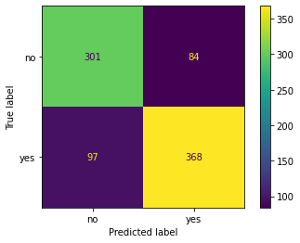
05
Data Training and Testing
We create the following 5 model: Logistic Regression , Support Vector Machine, KNN, Decision Tree, Random Forest. We train the model using the train data, we test the model on the test data then we evaluate the model using confusion matrix, accuracy, precision, recall, and f1-score
Logistic Regression
churn | precision | recall | F1-score
no | 76% | 78% | 77%
yes | 81% | 79% | 80%
Accuracy |  |  | 79%

Slide 18
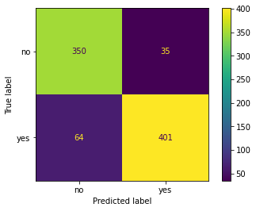
05
Data Training and Testing
Support Vector Machine
churn | precision | recall | F1-score
no | 85% | 91% | 88%
yes | 92% | 86% | 89%
Accuracy |  |  | 88%

Slide 19
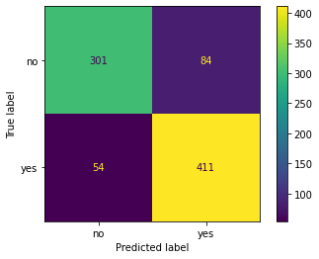
05
Data Training and Testing
KNN
churn | precision | recall | F1-score
no | 85% | 78% | 81%
yes | 83% | 88% | 86%
Accuracy |  |  | 84%

Slide 20
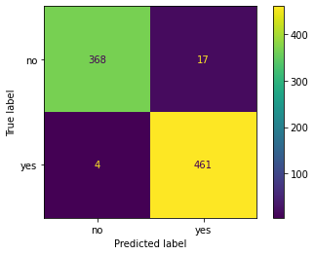
05
Data Training and Testing
Decision Tree
churn | precision | recall | F1-score
no | 99% | 96% | 97%
yes | 96% | 99% | 98%
Accuracy |  |  | 98%

Slide 21
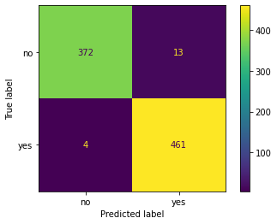
05
Data Training and Testing
Random Forest
churn | precision | recall | F1-score
no | 99% | 97% | 98%
yes | 97% | 99% | 98%
Accuracy |  |  | 98%

Slide 22
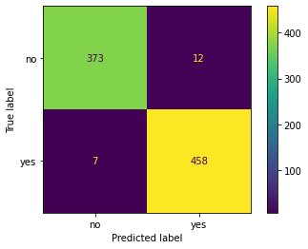
06
Ensemble Method
After creating the 5 model we can perform ensemble method majority voting. Then we evaluate it using confusion matrix, accuracy, precision, recall, and f1-score
churn | precision | recall | F1-score
no | 99% | 97% | 98%
yes | 97% | 99% | 98%
Accuracy |  |  | 98%

Slide 23
Summary
Model | churn | precision | recall | F1-score
Logistic Regression | no | 76% | 78% | 77%
 | yes | 81% | 79% | 80%
Support Vector Machine | no | 85% | 91% | 88%
 | yes | 92% | 86% | 89%
KNN | no | 85% | 78% | 81%
 | yes | 83% | 88% | 86%
Decision Tree | no | 99% | 96% | 97%
 | yes | 96% | 99% | 98%
Random Forest | no | 99% | 97% | 98%
 | yes | 97% | 98% | 98%
Ensemble Method | no | 98% | 97% | 98%
 | yes | 97% | 98% | 98%

Slide 24
Conclusion
Based on the model evaluation, we can consider using the Random Forest model because it perform best
Recommendation
It’s recommended to approach/engage customer that is predicted as churn to maximize customer retention

Slide 25
THANKS
Please keep this slide for attribution

